Slide 1
Using GraphQL over REST How to deliver the right APIs & Experiences to Consumers

Slide 2


Housekeeping
Session is being recorded
Temil Sanchez
Product Owner
Nathan Wright
Technical Product Manager
Please post questions to Q+A
Open Q+A at end

Slide 3
2009
11
founded
global offices
6.5M+
22,000+
users
customers
5
525+
free tools
employees

Slide 4












Manage
Analyze and improve all of your testing
Native Jira & enterprise test management
Zephyr
TestComplete
Automated UI functional testing
LoadNinja
Automated UI performance testing
UI
CrossBrowserTesting
HipTest
Run Selenium & Appium tests in the cloud
Design features & tests using BDD
Test mobile apps on real devices in the cloud
Design
Commit
Test
Deploy
Monitor
Collaborate on user stories, tests, and code
Commit and push new code and tests to kick off CI
Create, manage, and execute automated tests
Deploy to production once tests and builds pass
Monitor the performance of your APIs and web apps
SwaggerHub
SoapUI Pro
AlertSite
Design, model, & share API definitions
API
Automated API functional & security testing
Global, synthetic API monitoring
Accelerate & manage API functional testing
LoadUI Pro
Automated API performance testing
ServiceV Pro
Collaborator
Code, document, & artifact review
Virtualize APIs, UIs, and web services
Review
Reduce defects and improve trust with code review

Slide 5
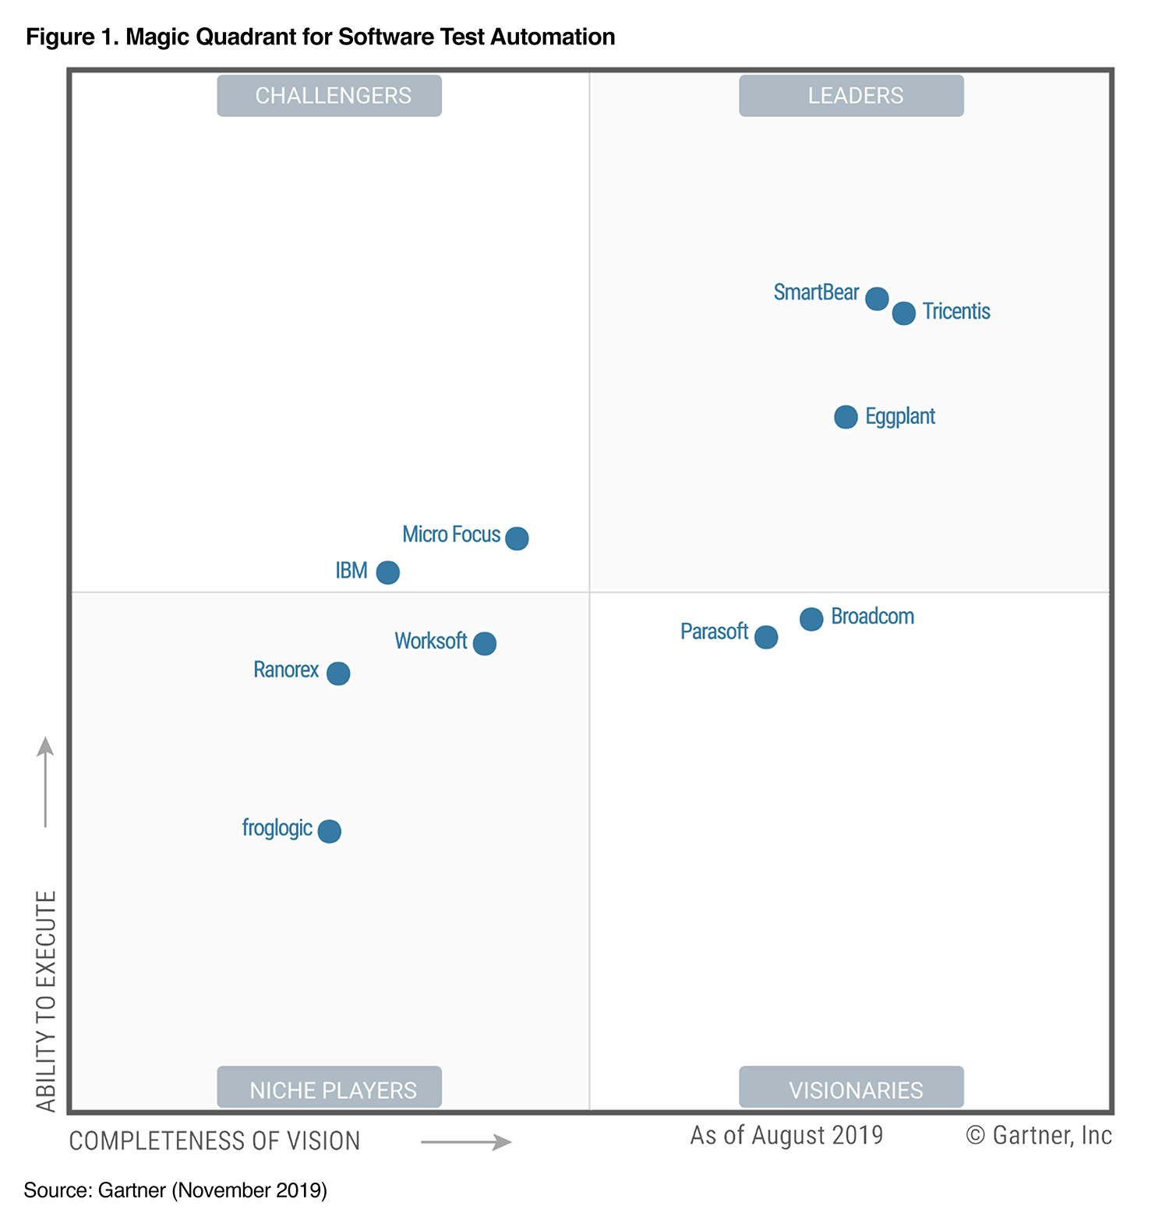
SmartBear Recognition
Gartner
“SmartBear is a Leader. The company has executed well on its vision for enabling continuous testing
through recent acquisitions including Cucumber and Bitbar, as well as organic development. Consider SmartBear if you are looking for broad technology support including open-source and
testing at scale in the cloud.”
Gartner Magic Quadrant TM : Software Test Automation 2019
Gartner Magic Quadrant for Software Test Automation, by Joachim Herschmann, Thomas Murphy, Jim Scheibmeir, November 25, 2019.
Gartner does not endorse any vendor, product or service depicted in its research publications, and does not advise technology users to select only those vendors with the highest ratings or other designation. Gartner research publications consist of the opinions of Gartner's research organization and should not be construed as statements of fact. Gartner disclaims all warranties, expressed or implied, with respect to this research, including any warranties of merchantability or fitness for a particular purpose. This graphic was published by Gartner, Inc. as part of a larger research document and should be evaluated in the context of the entire document. The Gartner document is available upon request from SmartBear
Notes:
We’ve been recognized by the largest, most-prestigious third party research and analyst firms for being the leading, first-look solutions in Test Automation, API Lifecycle, Service Virtualization, and more. We most recently placed as Leaders in the Gartner’s Magic Quadrant on Software Test Automation, ranking as the highest vendor in our ability to execute for our customers.

Slide 6
Comparing API Technologies

Slide 7
REST APIs
Representational Stateful Transfer
A software architecture style that defines the way two systems “talk” to each other using a common language over HTTP – mostly made up of GET, POST, PUT, & DELETE.
When a request is made to a RESTful web service’s URL, it will respond with a payload formatted in HTML, XML, or JSON.
RESTful APIs have several description language to help with consumption. The most popular definitions are OAS(f.k.a Swagger), RAML, API Blueprint and others.
Notes:
Optional notes:
REST
Design architecture / standard
REST talked about as early as 2000
Industry knowledge & tooling, heavily adopted
Multiple description formats
OpenAPI, Swagger, RAML, Blueprint, …

Slide 8
GraphQL
A Query Language
A query language that provides a common interface between two systems for fetching and manipulating data.
It’s not quite like REST, but GraphQL has a recognizable and standard schema for “talking” to a machine.
Notes:
Optional notes:
GraphQL
Invented by a team at Facebook in 2012
Designed to deliver large amounts of data, quickly
Native documentation
Simple to adopt query language
Easy for consumers to jump right in

Slide 9
CRUD Actions
Common
Both methodologies have best practices that are not always followed. E.g In REST some POST messages are used to updates or Get are used to add data to a DB as in GQL Queries can create/update or delete data if an inputType is used which is what a resolver would expand and execute....Wait what? InputType? Resolver? Then why do we need Query and mutations?
REST
Uses POST to Create data
Uses GET to Read/Get data from server
Uses UPDATE to Modify or update the server(some use post but it is not a good practice)
Uses DELETE to remove data from a server
GraphQL
Uses Query to read from a Server
Uses Mutations to Create, Update or Delete data from the server

Slide 10
CRUD Actions
Action | REST | GraphQL
Create | POST | Mutation
Read | GET | Query
Update | PUT / PATCH | Mutation
Delete | DELETE | Mutation
Common
Both methodologies have best practices that are not always followed.
For example,
In REST some POST messages are used to updates or Get are used to add data to a DB
GQL Queries can create/update or delete data if an inputType is used which is what a resolver would expand and execute....
Wait what? InputType? Resolver? Then why do we need Query and mutations?

Slide 11
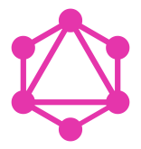
Glossary
| Query
Query server to get the data that is needed
| Mutation
Update, Delete or Create data
| Scalar Types
Similar to primitive types in your favorite programming language. They always resolve to concrete data.
| Input Types
Special object types that allow you to pass objects as arguments to queries and mutations
| Resolver
Functions that are used to fetch/update data from the server and ties back directly to the schema and what was requested in a query/ mutation
Proprietary & Confidential

Slide 12
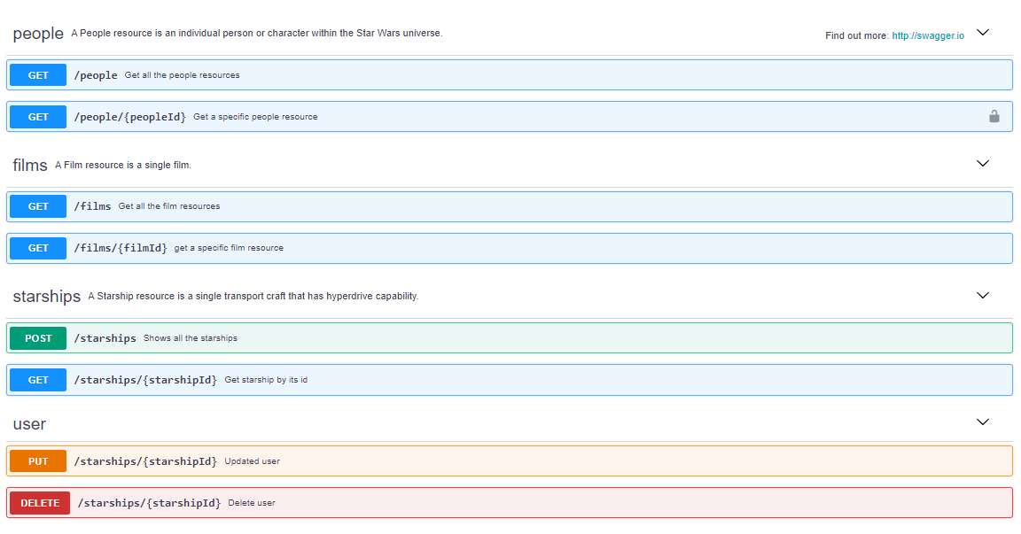
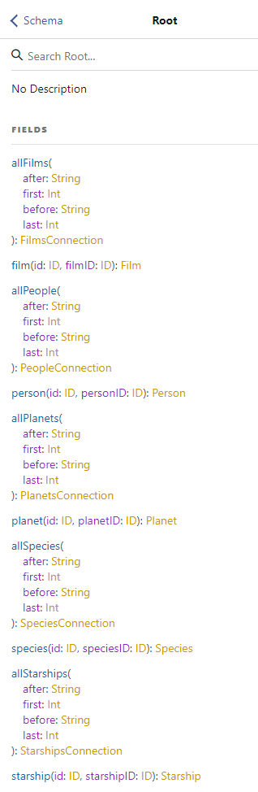
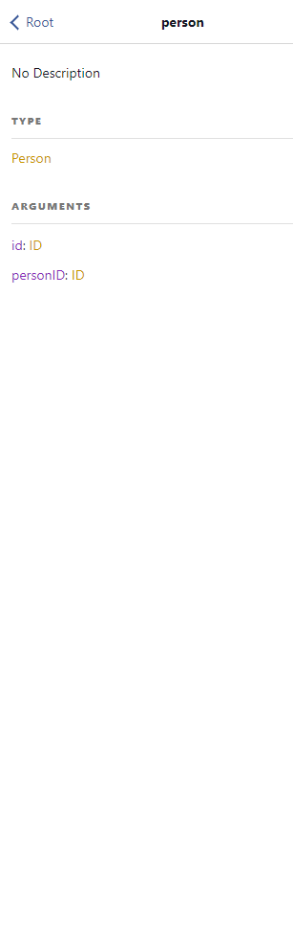
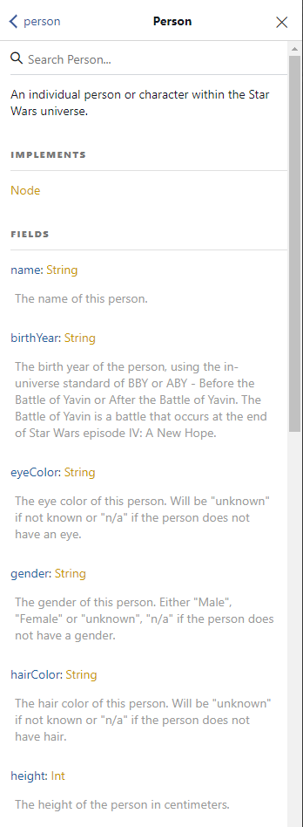
Built In Documentation
REST (OpenAPI)
GraphQL
Notes:
This slide is mainly to explain documentation importance
Talk about OAS and how the REST industry has embraced it but still not something that is set on stone
Graphqls schema has a directly relationship with the implementation which makese it mandatory

Slide 13
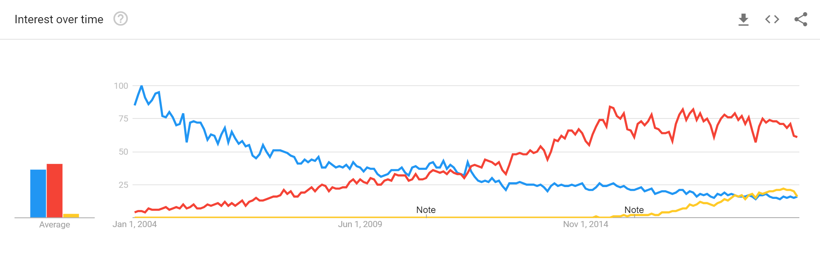
Shifting Interest
SOAP
REST
GraphQL
Notes:
Over the Years we can see how REST has taken over the API world and has really been predomenant way of building APIs hence the intrest shift on this graph. GraphQL is catching the industry's intrest as well as you can see it increment since 2014 and this is do to the different needs to reduce redundt data collection or overfetching of data which leads to performance degradation and other items. There are more benefits to GQL stay tuned.

Slide 14




Exploring Adoption
| Github
Went live with there v4 of their API using GraphQL because of the flexibility GQL has when it comes to requesting data
| Netflix
Use GraphQL for an internal application that manages the creation and assembly of ads
| Facebook
Originally produced the idea, expanded the use of GraphQL to many of their internal platforms, especially for components used by the mobile app
| Paypal
Use GraphQL for their checkout platform which lead to better performance, more flexibility on the client side and developer productivity.
Proprietary & Confidential

Slide 15
Working with GraphQL vs REST

Slide 16
REST Consumer Workflow
As a third party developer and consumer of this API, I am building a mobile application that will
Show a list of all ‘people’ in the Star Wars universe
Allow users to select a person from this list
Show a person page with their information, and the films they were in
GET /people
{
"count" : 87,
"next" : "https://swapi.co/api/people/?page=2",
"previous" : null,
"results" : [
{
"name" : "Luke Skywalker",
“url" : https://swapi.co/api/people/1/
},
{
"name" : "C-3PO",
“url" : https://swapi.co/api/people/2/
},
{
"name" : "R2-D2",
"url" : https://swapi.co/api/people/3/
},
...
]
}
Service Management
https://www.swapi.io/api/
Proprietary & Confidential
Notes:
Now that we’ve looked at some of the industry trends and adoption of GraphQL, lets look at a practical example to explore how REST and GQL are different and where one might work better than another.
We are first going to look at working with a RESTful service as an API consumer, in our example (and what will be demoed later) is a list of requirements we want to work through.
We are building a new application that uses this API to show characters, and lets people get some more info on a specific character they select along with the films they appear in.
The way things are built now, getting a list of characters is pretty straightforward – there is a single /people call defined in the API specification that returns all of them
Once we get that back, there is a link to specific character data, so when a users selects a name, we can imagine we want to load this link and render it on the character page

Slide 17
REST Consumer Workflow
As a third party developer and consumer of this API, I am building a mobile application that will
Show a list of all ‘people’ in the Star Wars universe
Allow users to select a person from this list
Show a person page with their information, and the films they were in
GET /people/1
{
"name" : "Luke Skywalker",
"height" : "172",
"mass" : "77",
"hair_color" : "blond",
"skin_color" : "fair",
"eye_color" : "blue",
"birth_year" : "19BBY",
"gender" : "male",
"homeworld" : "https://swapi.co/api/planets/1/",
"films" : [
"https://swapi.co/api/films/2/",
"https://swapi.co/api/films/6/",
"https://swapi.co/api/films/3/",
"https://swapi.co/api/films/1/",
"https://swapi.co/api/films/7/"
],
...
}
Service Management
https://www.swapi.io/api/
Proprietary & Confidential
Notes:
In this API, when we get the specific character data back, it includes all the info we want to show on our character page – things like hair color, height, etc.
We can also see that the other information we want (the films they appear in) is listed, but is stored under a sperarate resource - /films
The same issue presents itself if we wanted to show the name of the characters homeworld – in this example, it is a reference to another resource we would have to query

Slide 18
REST Consumer Workflow
GET /films/2
As a third party developer and consumer of this API, I am building a mobile application that will
Show a list of all ‘people’ in the Star Wars universe
Allow users to select a person from this list
Show a person page with their information, and the films they were in
GET /films/6
Service Management
GET /films/3
GET /films/1
GET /films/7
{
"title" : “The Empire Strikes Back",
"episode_id" : 5,
"opening_crawl" : "It is a dark time for the…”
"url" : "https://swapi.co/api/films/2/
}
https://www.swapi.io/api/
{
"title“ : “Revenge of the Sith",
"episode_id“ : 3,
"opening_crawl“ : “War! The Republic is …”
"url" : "https://swapi.co/api/films/6/
}
Proprietary & Confidential
Notes:
In order to show the names of these films, we will either have to create some kind of workaround, or make a call to the /films resource for every film, get the name from the response and then show that in the application
This means the user might see a ‘loading’ screen or icon while our application collects together this data. For this, its only 5 calls – but as the application grows, and if we wanted to show data about something like the vehicles they traveled in or planets visited – the number of these requests will grow and most likely create performance issues for our users.
This is exactly the type of thing that GraphQL will be able to help us with – but before we jump into how the client flow changes, we will look quickly at the provider’s workflow on the other side of these transactions

Slide 19





REST Provider Workflow
Service Layer
/people
Service Management
Data Layer
Logs
/films
| PERSON | SPECIES | FILM_ID |
GET /people
Authentication
/starships
| FILM |
https://www.swapi.io/api/
Gateway
/vehicles
| VEHICLE | TYPE | PERSON_ID |
/species
Documentation
| PLANET | FILM_ID |
/planets
Proprietary & Confidential
Notes:
So on the screen we have a basic representation of what the API might look like
We can see there is a service management layer that is designed to handle authentication, logging, and acts as our documentation portal
This is a layer over a number of discreet services – in this case one for each resource, people, films, planets etc.
These services interact with our data store that is broken down into tables. This could be something like a relational database that has IDs and references to other tables, allowing us to pull data sets across servoces without having to dig to far into each individual table.
On the left side, a call from the client comes in and hits our gateway starting off our workflow

Slide 20
REST Provider Workflow
Service Layer
/people
Service Management
Data Layer
Logs
/films
| PERSON | SPECIES | FILM_ID |
GET /people
Authentication
/starships
| FILM |
https://www.swapi.io/api/
Gateway
/vehicles
| VEHICLE | TYPE | PERSON_ID |
/species
Documentation
| PLANET | FILM_ID |
/planets
Proprietary & Confidential
Notes:
The gateway handles the authentication check, and then routes the request to the correct API – in this case /people

Slide 21
REST Provider Workflow
Service Layer
/people
Service Management
Data Layer
Logs
/films
| PERSON | SPECIES | FILM_ID |
GET /people
Authentication
/starships
| FILM |
https://www.swapi.io/api/
Gateway
/vehicles
| VEHICLE | TYPE | PERSON_ID |
/species
Documentation
| PLANET | FILM_ID |
/planets
Proprietary & Confidential
Notes:
The /people service pulls the data set it needs from our back end, and formats it to return back to the client
This is pretty straight forward, and works well as we are returning pretty much all the data from the query, back to the client

Slide 22
REST Provider Workflow
Service Layer
/people
Service Management
Data Layer
Logs
/films
| PERSON | SPECIES | FILM_ID |
GET /films/{id}
Authentication
/starships
| FILM |
https://www.swapi.io/api/
Gateway
/vehicles
| VEHICLE | TYPE | PERSON_ID |
/species
Documentation
| PLANET | FILM_ID |
/planets
Proprietary & Confidential
Notes:
When it comes to those specific /film requests based on an ID, a similar flow happens but we end up looking up information across tables, flattening that and then returning the response
In our previous example, we have 5 /film requests coming in from a single client – all of which will have to be handled and returned one by one. If our services start to lookup data across tables, we are going to have a lot of moving parts and values that have to be handled correctly and in a short amount of time to keep our consumers happy.

Slide 23
GraphQL Consumer Workflow
query {
allPeople {
edges {
node {
name
id
}
cursor
}
totalCount
}
}
As a third party developer and consumer of this API, I am building a mobile application that will
Show a list of all ‘people’ in the Star Wars universe
Allow users to select a person from this list
Show a person page with their information, and the films they were in
Service Management
{
"data" : {
"allPeople" : {
"edges" : [
{
"node" : {
"name" : "Luke Skywalker",
"id" : "cGVvcGxlOjE="
}
},
{
"node" : {
"name" : "C-3PO",
"id" : "cGVvcGxlOjI="
}
},
...
}
https://swapi-graphql.netlify.com/.netlify/functions/index
Proprietary & Confidential
Notes:
So we know what our workflow is with the RESTful service – lets instead take a look at the same steps but using a GraphQL API
To start, we will mirror the workflow we just performed.
This service has an ‘allPeople’ query that will allow us to get back information about all characters – in this case, lets do the same as before and get back name, and the ID to find their specific data
The response coming back looks pretty similar to before, but instead of a link to each resource, we instead are getting a unique identifier

Slide 24
GraphQL Consumer Workflow
query {
person(id: "cGVvcGxlOjE=") {
name
...
filmConnection {
totalCount
films {
id
title
openingCrawl
}
}
}
}
As a third party developer and consumer of this API, I am building a mobile application that will
Show a list of all ‘people’ in the Star Wars universe
Allow users to select a person from this list
Show a person page with their information, and the films they were in
{
"data" : {
"person" : {
"id" : "cGVvcGxlOjE=",
"name" : "Luke Skywalker",
...
"filmConnection" : {
"totalCount" : 5,
"films" : [
{
"id" : "ZmlsbXM6MQ==",
"title" : "A New Hope",
"openingCrawl" : "It is a period of civil war..."
},
{
"id" : "ZmlsbXM6Mg==",
"title" : "The Empire Strikes Back",
"openingCrawl" : "It is a dark time for..."
},
...
}
https://swapi-graphql.netlify.com/.netlify/functions/index
Proprietary & Confidential
Notes:
Now that we have that ID, we can do something similar to our other workflow where we use a ‘person’ query with that ID as the argument, and get the data back
The major difference here is that we can define *exactly* the information we want to come back, so maybe we care about name, height and hair color – but not so much the eye color or birth year
We can also use this line of thinking to pull back the data we need for other, associated values – in this case we know we want film data so we can use the provided ‘filmConnection’ query to get what previously would’ve taken us many more calls.
This saves us as the consumers a huge amount of time – and we can actually take it a step further!

Slide 25
GraphQL Consumer Workflow
query {
allPeople {
edges {
node {
name
id
birthYear
eyeColor
gender
hairColor
height
mass
skinColor
filmConnection {
totalCount
films {
id
title
openingCrawl
}
}
}
}
totalCount
}
}
As a third party developer and consumer of this API, I am building a mobile application that will
Show a list of all ‘people’ in the Star Wars universe
Allow users to select a person from this list
Show a person page with their information, and the films they were in
Service Management
https://swapi-graphql.netlify.com/.netlify/functions/index
Proprietary & Confidential
Notes:
If we go back to the first, allPeople query – we could even use that filmConnection option from the last slide to get all the data we need in a single query!

Slide 26
GraphQL Consumer Workflow
{
"data" : {
"allPeople" : {
"edges" : [
{
"node" : {
"name" : "Luke Skywalker",
"id" : "cGVvcGxlOjE=",
"birthYear" : "19BBY",
"eyeColor" : "blue",
"gender" : "male",
"hairColor" : "blond",
"height" : 172,
"mass" : 77,
"skinColor" : "fair",
"filmConnection" : {
"totalCount" : 5,
"films" : [
{
"id" : "ZmlsbXM6MQ==",
"title" : "A New Hope",
"openingCrawl" : "It is a period of civil war…
},
{
"id" : "ZmlsbXM6Mg==",
"title" : "The Empire Strikes Back",
"openingCrawl" : "It is a dark time…
},
{
"id" : "ZmlsbXM6Mw==",
"title" : "Return of the Jedi",
"openingCrawl" : "Luke Skywalker has returned…"
},
{
"id" : "ZmlsbXM6Ng==",
"title" : "Revenge of the Sith",
"openingCrawl" : "War! The Republic…"
},
{
"id" : "ZmlsbXM6Nw==",
"title" : "The Force Awakens",
"openingCrawl" : "Luke Skywalker has vanished…"
}
]
}
...
}
},
As a third party developer and consumer of this API, I am building a mobile application that will
Show a list of all ‘people’ in the Star Wars universe
Allow users to select a person from this list
Show a person page with their information, and the films they were in
Service Management
https://swapi-graphql.netlify.com/.netlify/functions/index
Proprietary & Confidential
Notes:
This will mean what previously may have taken 7 or 8 requests with REST (or more as our requirements grow), is now taking us just a single query for every character we could possibly want to show in our application
Of course, depending on the size of the data set this might not be the best option, but providers are giving consumers the flexibility to choose the data they want, when they want it, which is extremely powerful.

Slide 27
GraphQL Provider Workflow
Service Layer
/people
Service Management
Data Layer
Logs
/films
| PERSON | SPECIES | FILM_ID |
query
Authentication
/starships
| FILM |
https://swapi-graphql.netlify.com
Gateway
/vehicles
| VEHICLE | TYPE | PERSON_ID |
/species
Documentation
| PLANET | FILM_ID |
/planets
Proprietary & Confidential
Notes:
So what is different on the provider side?
Under the hood – things look pretty similar, we have our same collection of smaller services that are connected and pulling back values from our data layer
What has change is that we’ve introduced a ‘graph’ layer over them all, so the client interacts with a single interface that understands the map of the internal/driving services, and can translate values from the query out and resolve the data that is returned.
This is a simple example of some pretty complex and amazing technology, but hopefully starts to highlight some of the reasons teams would look to not only want to consume GraphQL services, but also

Slide 28
GraphQL Provider Workflow
Service Layer
/people
Service Management
Data Layer
Logs
/films
| PERSON | SPECIES | FILM_ID |
query
Authentication
/starships
| FILM |
https://swapi-graphql.netlify.com
Gateway
/vehicles
| VEHICLE | TYPE | PERSON_ID |
/species
Documentation
| PLANET | FILM_ID |
/planets
Proprietary & Confidential
Notes:
So what is different on the provider side?
Under the hood – things look pretty similar, we have our same collection of smaller services that are connected and pulling back values from our data layer
What has change is that we’ve introduced a ‘graph’ layer over them all, so the client interacts with a single interface that understands the map of the internal/driving services, and can translate values from the query out and resolve the data that is returned.
This is a simple example of some pretty complex and amazing technology, but hopefully starts to highlight some of the reasons teams would look to not only want to consume GraphQL services, but also

Slide 29
Demo

Slide 30
Will GraphQL Replace REST?

Slide 31



APIs Designed to Serve Different Needs
| Continued Growth of Microservices
Microservices are changing both the internal and external API landscape
It is critical that the right service type is used – GQL doesn’t make sense for everything (just like REST doesn’t make sense in some use cases)
| Consumer / Developer Experience
Developer experience is driving innovation and competition in the market
Delivering an enjoyable DX to partners and consumers (both internal and external) can help drive adoption and growth
| API Economy
Companies are increasingly looking at how APIs can be a new channel for business
APIs and data being shared across providers is driving innovation, allowing teams to build new functionality through integrations instead of starting from the ground up
Proprietary & Confidential

Slide 32
APIs Designed to Serve Different Needs
| REST
Request / Response pattern that translate specific data and its current state to consumers
Defined, natural pattern and self linking values can help lead users down a ‘path’ across resources and references
| GraphQL
Strong at presenting large, complex data sets and maps to consumers
Can be used to deliver specific data to a variety of clients (mobile, web, etc.) through a single, consolidated interface
| Event-Based APIs
High-frequency triggers (events) can be organized and passed through a centralized service, designed to handle them at scale.
Commonly used in asynchronous scenarios
| RPC
Emerging as a major technology in serverless and cloud computing
Ties interface (API) directly to functions and business logic
Proprietary & Confidential

Slide 33
Testing GraphQL Services

Slide 34
Similar To Other API Testing Principles
Validate responses for
Functionality
SLAs
Security
Cover end-to-end scenarios
Ensure translation as new technologies are introduced
Use a broad range of data
Automate it in your CI/CD

Slide 35
Q+A
Thank You!

